Slide 1
Personalized SMS Campaign Architecture- Abandoned Cart Recovery
Balasubramanya B

Slide 2
Setting the Context
The purpose of this solution is to design a scalable, efficient, and personalized architecture for recovering abandoned carts by leveraging real-time customer data, multi-platform integration, and automated SMS workflows.
Combines SAP Commerce Cloud (abandoned cart detection), SAP CPI (middleware orchestration), SAP CDC (consent validation), BlueConic (profile enrichment), Dynamic Yield (personalization), and Iterable (workflow execution).
Offers real-time data flow that integrates transactional cart data and behavioral insights to create tailored experiences for users.
Adheres to GDPR/CCPA compliance by validating SMS consent before triggering recovery workflows.
Boosts customer engagement and improves cart recovery rates via actionable personalized SMS campaigns, paired with fallback mechanisms for error handling.

Slide 3
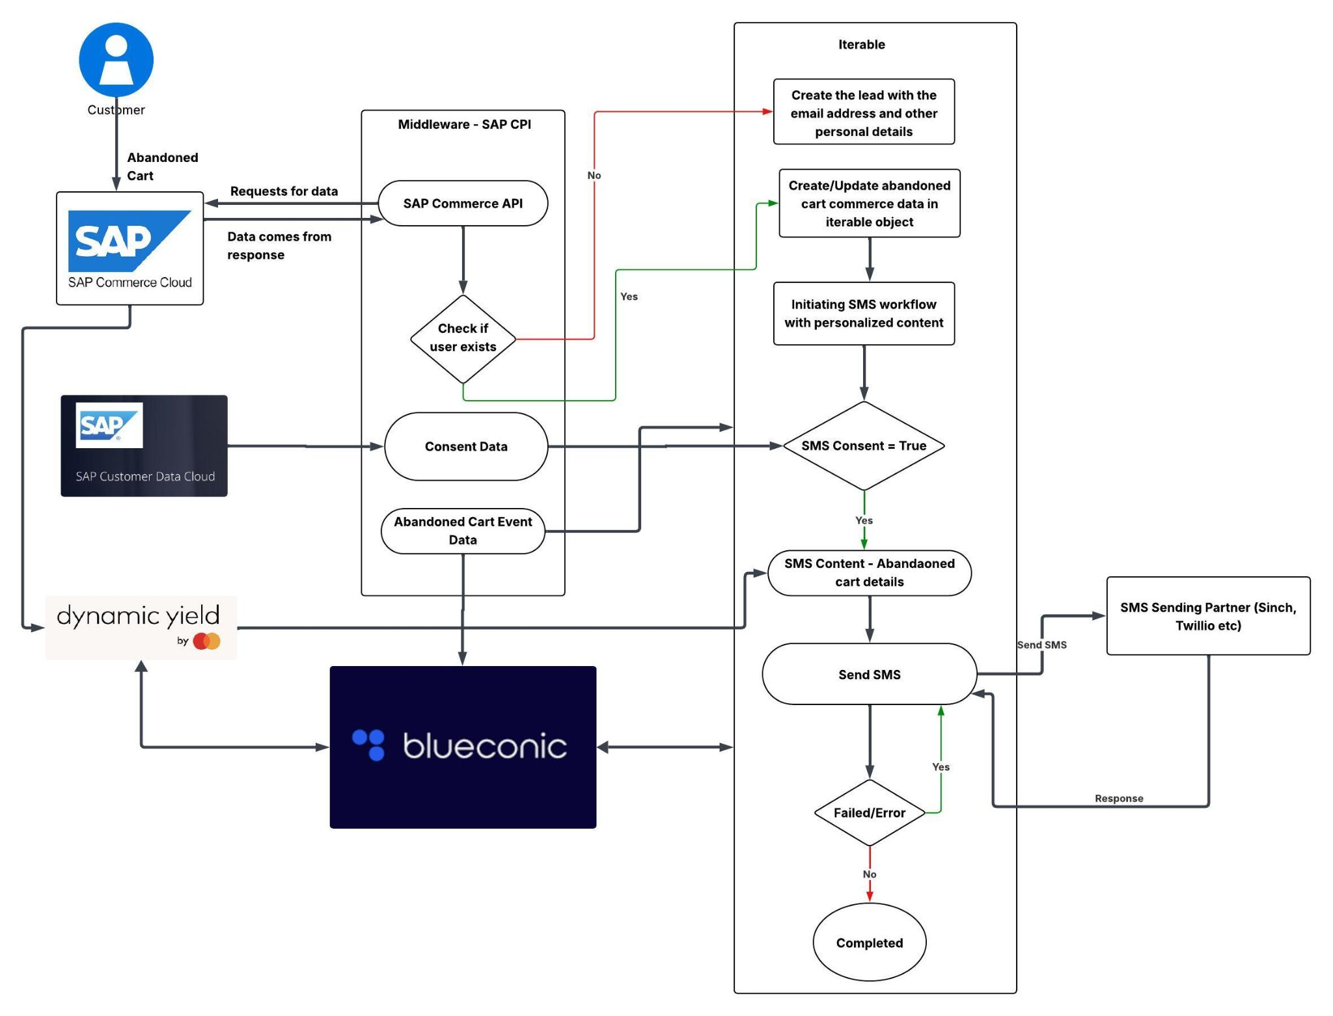
Solution Architecture

Slide 4
Platform Roles and Responsibilities
SAP Commerce (E-commerce Platform): Detects abandonment event and triggers data flow.
SAP CDC (Identity and Consent Management):Manages customer identity, opt-ins/consent, and compliance with privacy laws.
Ensures SMS reminders are sent only to those who have explicitly consented.
BlueConic (CDP): Enriches abandonment data with personalized attributes like preferences, behavior score, and cart content.
Iterable (Marketing Automation Platform):Orchestrates communication workflows, including SMS campaigns.
Dynamic Yield (Personalization):Orchestrates communication workflows, including SMS campaigns.
SAP CDC (Middleware):Manages customer identity, opt-ins/consent, and compliance with privacy laws.

Slide 5
Thank you

